Slide 1

Principle of
Cloud Computing
Chapter 1:
Cloud Computing fundamentals

Slide 2

Principle of Cloud Computing
Chapter 1:
Cloud Computing fundamentals
Dr. Mohammed Tawfik
Dr. Mohammed Tawfik

Slide 3
Outline
What is The Cloud Computing
Cloud computing history
Cloud computing architecture
cloud computing operations
cloud computing Provides
Essential Characteristics
Cloud Services types
Cloud Taxonomy
Virtualization
The advantage of cloud computing
The disadvantage of cloud computing
Dr. Mohammed Tawfik

Slide 4
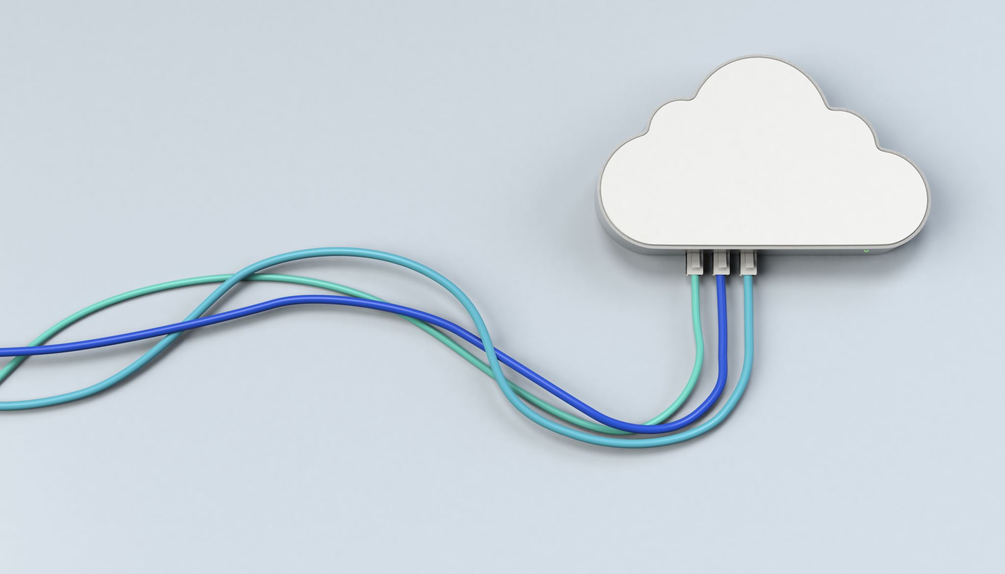
What is the definition of Cloud Computing ?
Give us your opinion

Slide 5
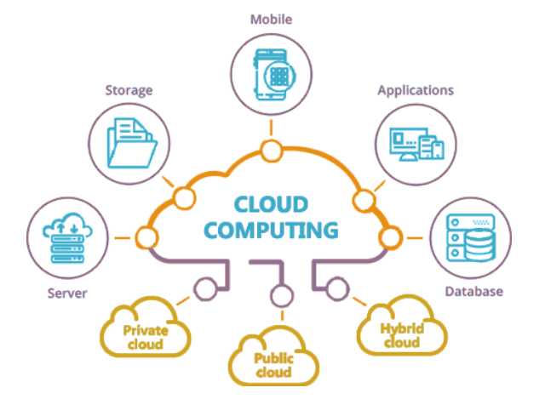
What is The Cloud Computing?

Slide 6
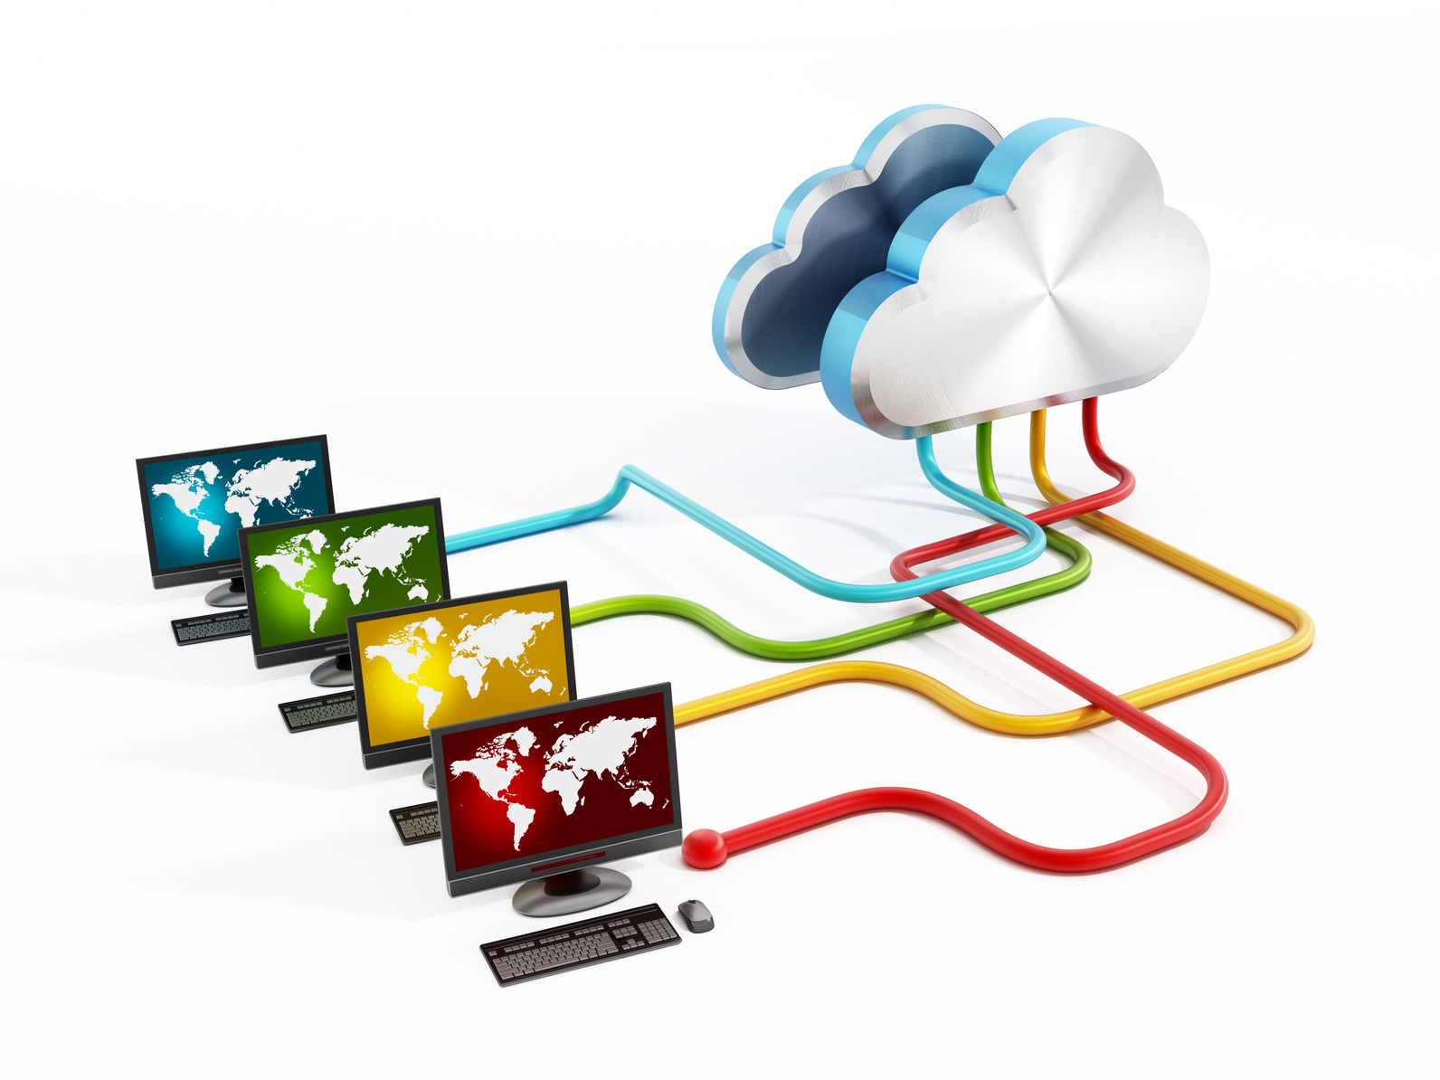
What is Cloud Computing?
What is Cloud Computing
Cloud Computing is a general term used to describe a new class of network-based computing that takes place over the Internet, It is a technology that uses remote servers on the internet to store, manage, and access data online rather than local drives. The data can be anything such as files, images, documents, audio, video, and more.
Or Cloud computing is using internet-connected remote computers to store, manage, and access your data and run programs, instead of using your own device. These remote computers (called "servers") can handle many types of data including files, images, documents, audio, and video.

Slide 7
Cloud computing history
The cloud has become essential to our digital lives today, but this wasn't always the case. Just a decade ago, the vast array of cloud services we now take for granted simply didn't exist. Today, nearly everything we do online connects to cloud technology - from downloading apps to storing our photos and videos. When cloud services are unavailable, our frustration reveals just how dependent we've become on this technology. But how did cloud computing evolve from a novel concept to the backbone of our digital world? Let's explore the journey of how cloud technology developed into the critical infrastructure we rely on daily.

Slide 8
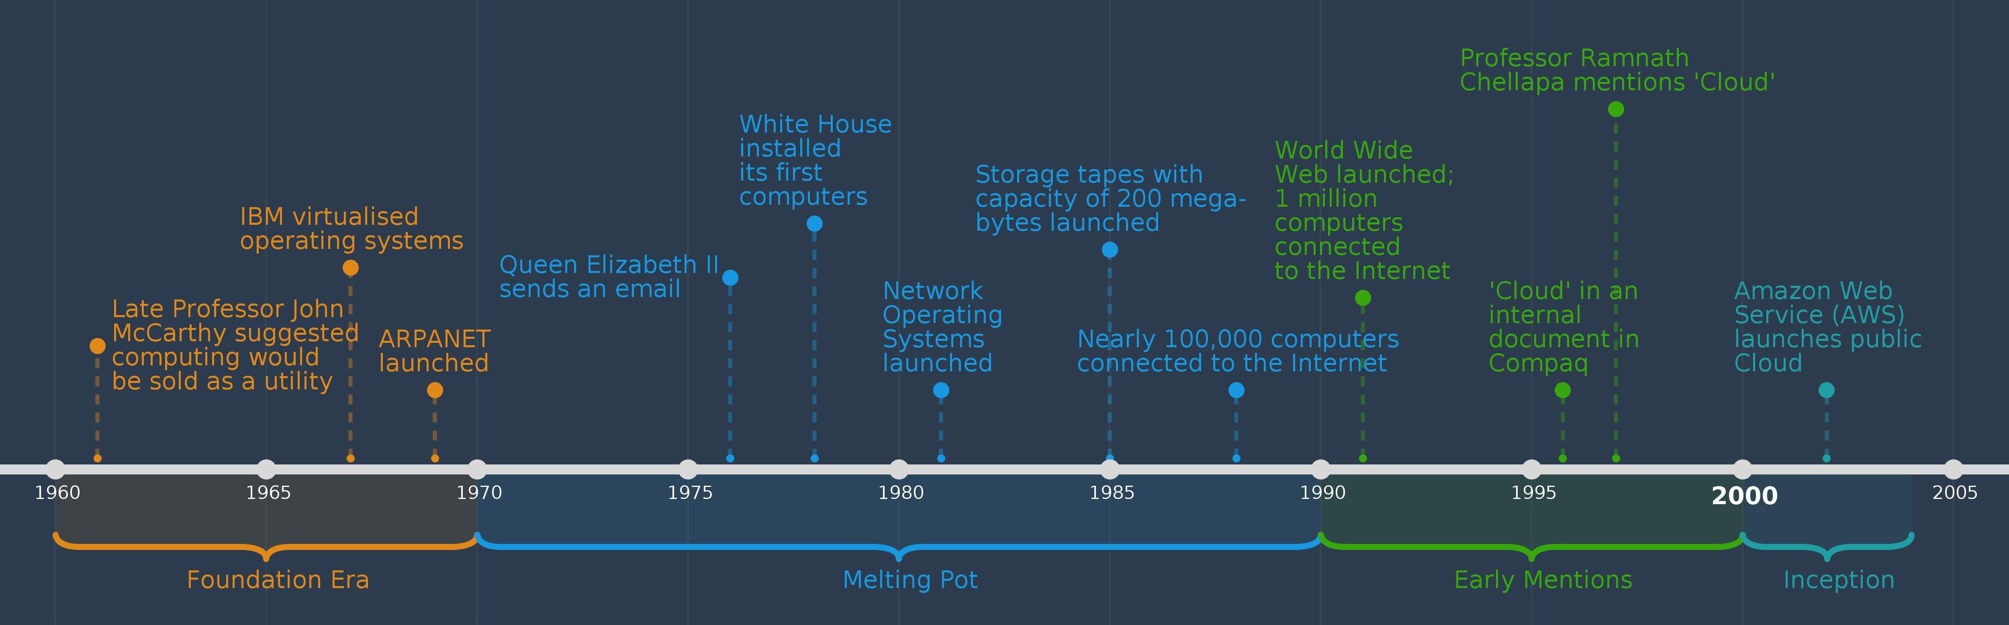
Cloud computing history
Cloud timeline 1960-2005

Slide 9
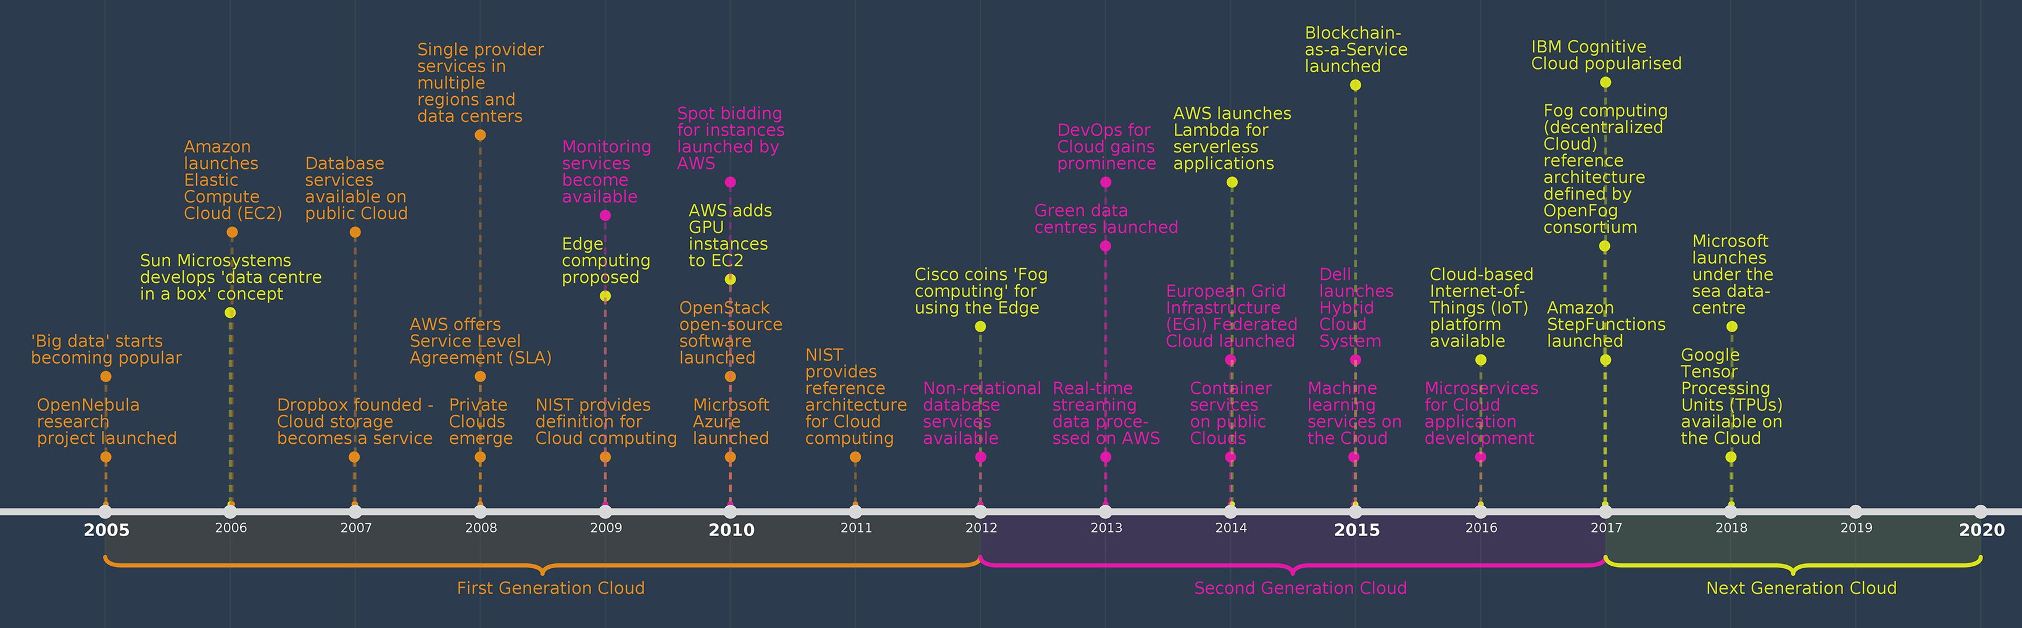
Cloud computing history
Cloud timeline 2005-2022
Dr. Mohammad Aladwan

Slide 10
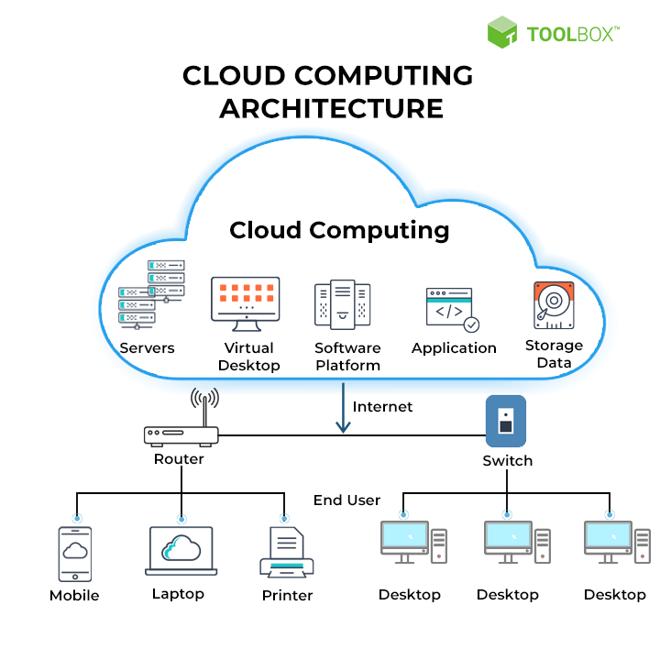
Cloud computing architecture

Slide 11
Cloud computing architecture
Cloud computing architecture is divided into the following two parts
Front End
The front end is used by the client. It contains client-side interfaces and applications that are required to access the cloud computing platforms. The front end includes web servers (including Chrome, Firefox, internet explorer, etc.), thin & fat clients, tablets, and mobile devices.
Back End
The back end is used by the service provider. It manages all the resources that are required to provide cloud computing services. It includes a huge amount of data storage, security mechanism, virtual machines, deploying models, servers, traffic control mechanisms, etc.
Functionality that uses internet-based resources
Only the interface dealt with on the client side.

Slide 12
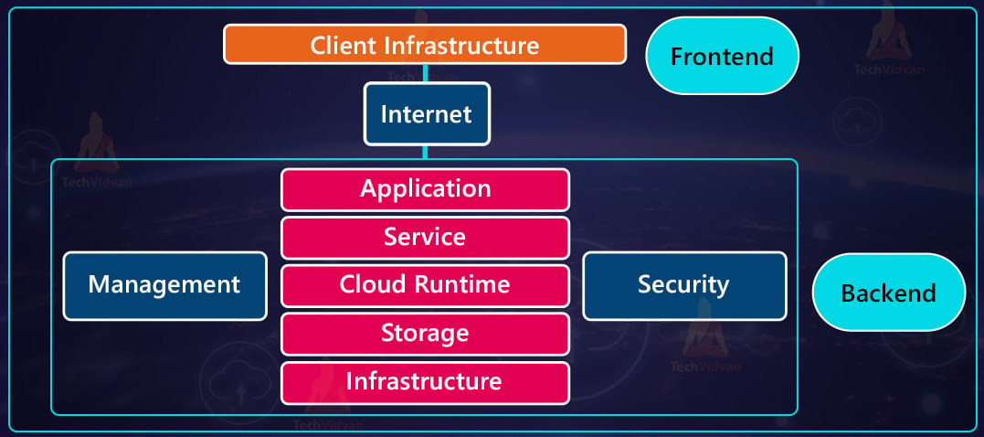
Cloud Computing Architecture

Slide 13

Components of Cloud Computing Architecture
There are the following components of cloud computing architecture -
1. Client Infrastructure
Client Infrastructure is a Front end component. It provides GUI (Graphical User Interface) to interact with the cloud.
2. Application
The application may be any software or platform that a client wants to access.
3. Service
A Cloud Services manages that which type of service you access according to the client’s requirement.

Slide 14

Cloud Computing Operations
There are the following operations that we can do using cloud computing:
Developing new applications and services
Storage, back up, and recovery of data
Hosting blogs and websites
Delivery of software on demand
Analysis of data
Streaming videos and audios

Slide 15
What It cloud computing Provides
Cloud computing provides shared services as opposed to local servers or storage resources
Enables access to information from most web-enabled hardware
Allows for cost savings – reduced facility, hardware/software investments, support

Slide 16

Service Level Agreement
Definition
A service-level agreement (SLA) is a contract between a network service provider and a customer that specifies, usually in measurable terms (QoS), what services the network service provider will furnish
Common content in contract
Performance guarantee metrics
Up-time and down-time ratio
System throughput
Response time
Problem management detail
Penalties for non-performance
Documented security capabilities

Slide 17
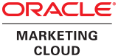
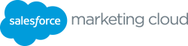
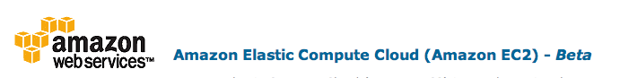
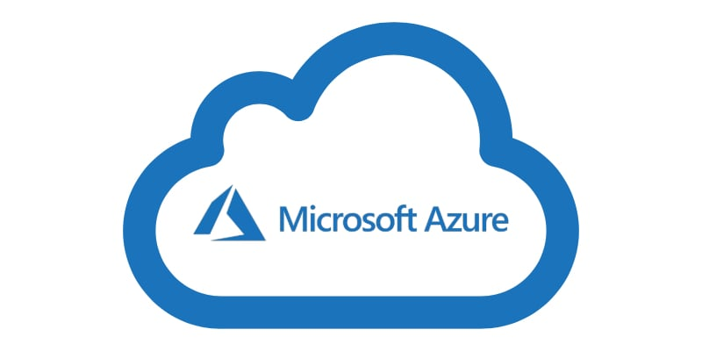
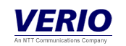

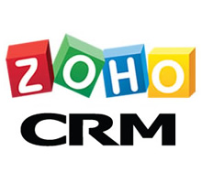
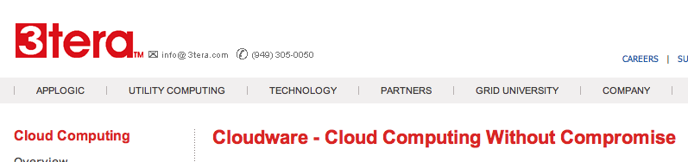

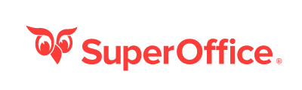

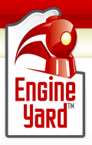

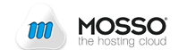
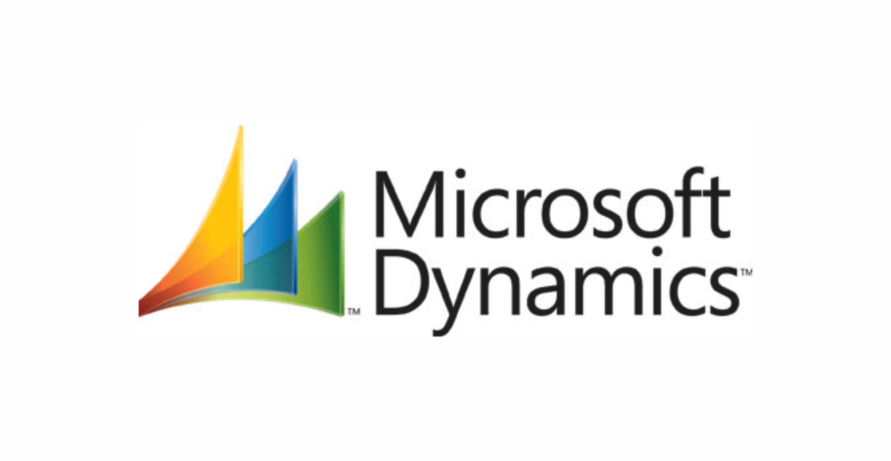
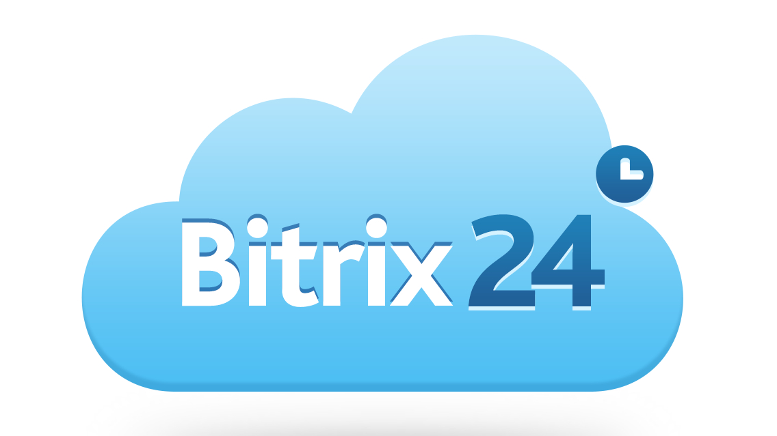
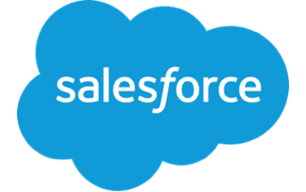



Some Commercial Cloud Provider

Slide 18
Essential Characteristics
On-demand self-service
A consumer can unilaterally provision computing capabilities, such as server time and network storage, as needed automatically without requiring human interaction with each service provider.
Broad network access
Capabilities are available over the network and accessed through standard mechanisms that promote use by heterogeneous thin or thick client platforms (e.g., mobile phones, tablets, laptops, and workstations).
Resource pooling
The provider’s computing resources are pooled to serve multiple consumers
Resources can be dynamically assigned and reassigned according to customer demand
Customer generally may not care where the resources are physically located but should be aware of risks if they are located offshore

Slide 19
Essential Characteristics
Rapid elasticity
Capabilities can be expanded or released automatically (i.e. more CPU power, or ability to handle additional users)
To the customer this appears seamless, limitless, and responsive to their changing requirements
Measured service
Customers are charged for the services they use and the amounts There is a metering concept where customer resource usage can be monitored, controlled, and reported, providing transparency for both the provider and consumer of the utilized service

Slide 20

Where Is My Data?
Data resides on servers that the customer cannot physically access
Vendors may store data anywhere at lowest cost if not restrained by agreement

Slide 21
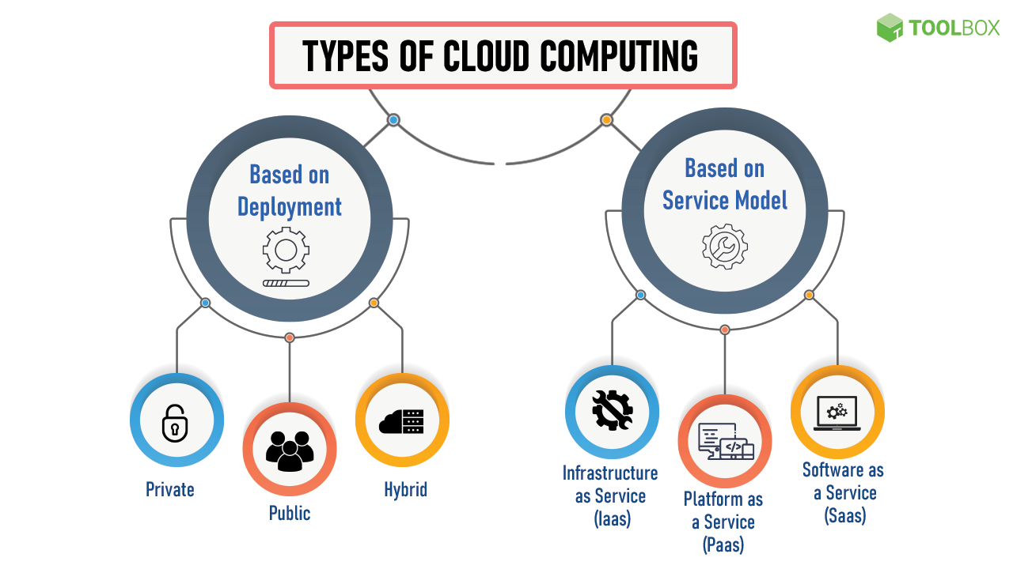

Slide 22
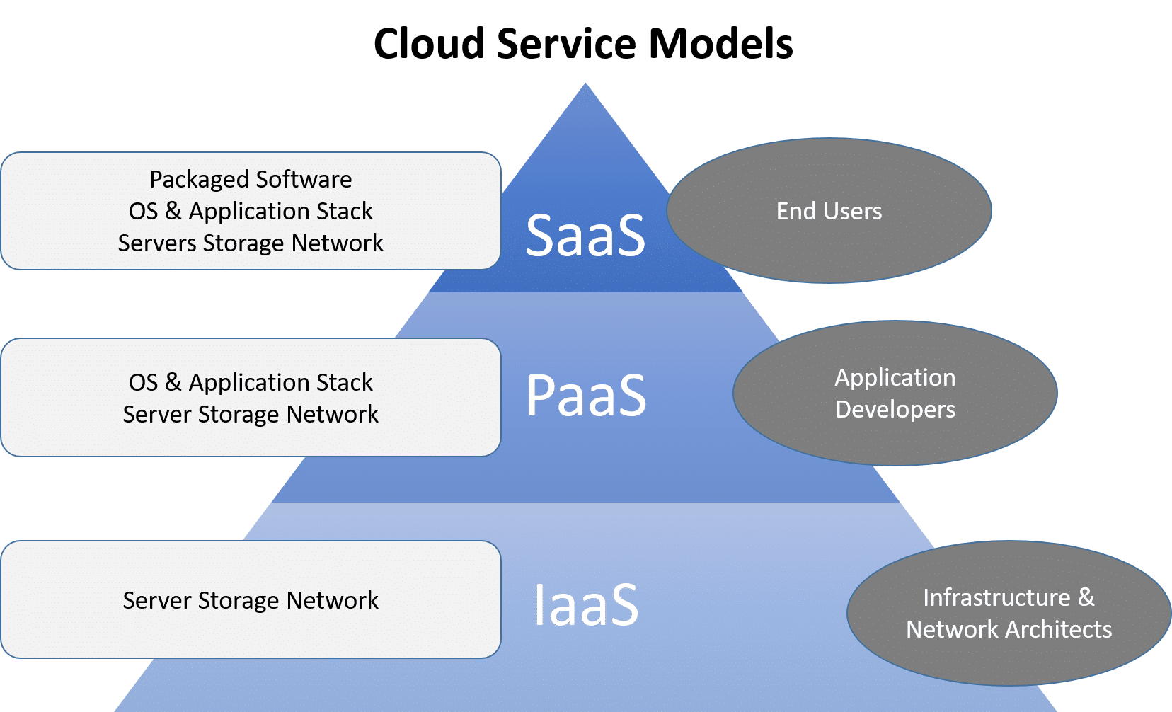
Service Models

Slide 23
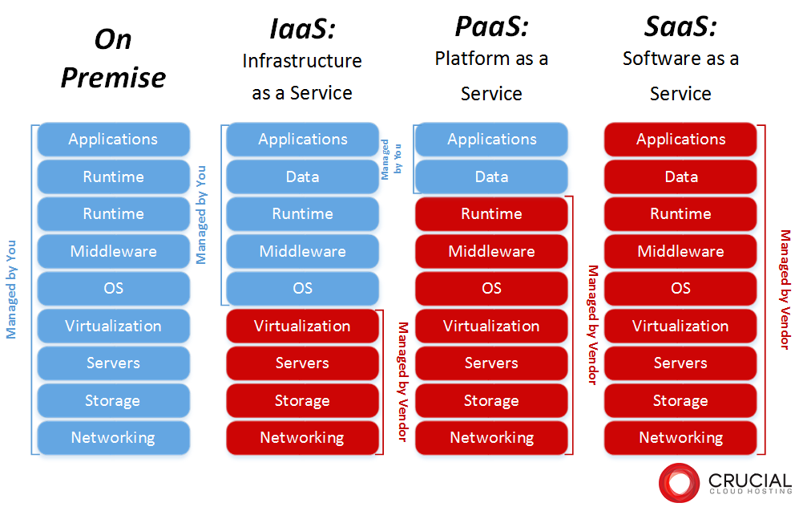

Slide 24
Service Models Software-as-a-Service (SaaS)
Software-as-a-Service (SaaS) Also referred to as “software on demand,” this service model involves outsourcing the infrastructure, platform, and software/applications.
Typically, these services are available to the customer for a fee, pay-as-you-go, or a no charge model.
The customer accesses the applications over the internet.

Slide 25

Service Models Platform-as-a-Service (PaaS)
Platform-as-a-Service (PaaS) A service model that involves outsourcing the basic infrastructure and platform (Windows, Unix)
PaaS facilitates deploying applications without the cost and complexity of buying and managing the underlying hardware and software where the applications are hosted.
The customer uses their own applications

Slide 26
Infrastructure-as-a-Service (IaaS)
A service model that involves outsourcing the basic infrastructure used to support operations--including storage, hardware, servers, and networking components.
The service provider owns the infrastructure equipment and is responsible for housing, running, and maintaining it. The customer typically pays on a per-use basis.
The customer uses their own platform (Windows, Unix), and applications
Service Models
Infrastructure-as-a-Service (IaaS)

Slide 27
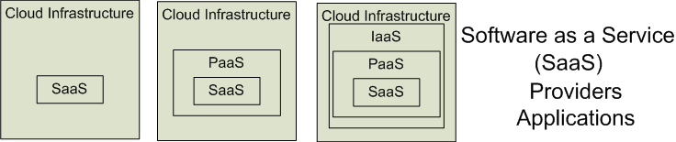

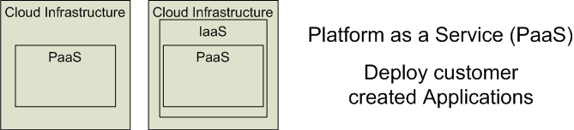
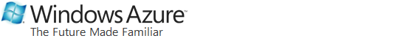
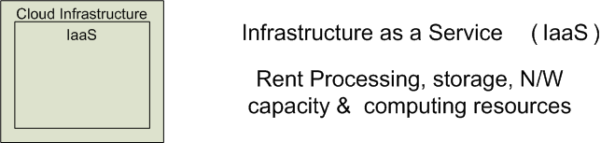
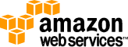

Cloud Service Models
Software as a Service (SaaS)
Platform as a Service (PaaS)
Infrastructure as a Service (IaaS)
SalesForce CRM
LotusLive
Google App Engine
Adopted from: Effectively and Securely Using the Cloud Computing Paradigm by peter Mell, Tim Grance
Notes:
IaaSdelivers computer infrastructure, typically a platform virtualization environment, as a service. Rather than purchasing servers, software, data center space or network equipment, clients instead buy those resources as a fully outsourced service.
PaaSdeliver a computing platform where the developers can develop their own applications.
SaaSis a model of software deployment where the software applications are provided to the customers as a service.

Slide 28
Deployment Model
There are four primary cloud deployment models :
Public Cloud
Private Cloud
Community Cloud
Hybrid Cloud
Each can exhibit the previously discussed characteristics; their differences lie primarily in the scope and access of published cloud services, as they are made available to service consumers.

Slide 29
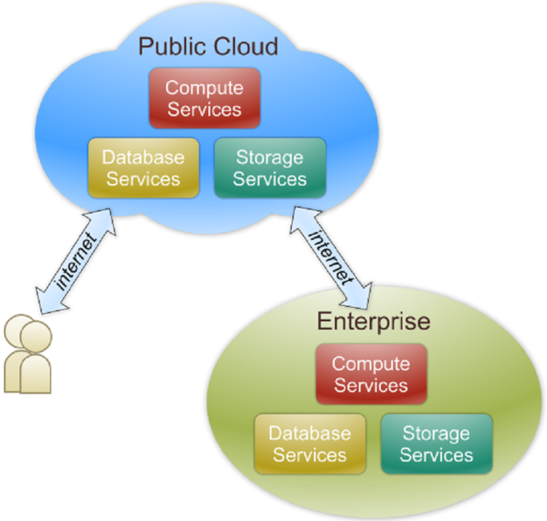
Public Cloud
Public cloud definition
The cloud infrastructure is made available to the general public or a large industry group and is owned by an organization selling cloud services.
Also known as external cloud or multi-tenant cloud, this model essentially represents a cloud environment that is openly accessible.
Basic characteristics :
Homogeneous infrastructure
Common policies
Shared resources and multi-tenant
Leased or rented infrastructure
Economies of scale

Slide 30
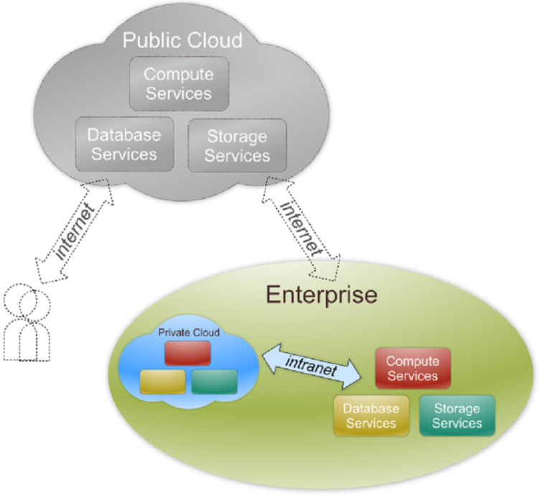
Private Cloud
Private cloud definition
The cloud infrastructure is operated solely for an organization. It may be managed by the organization or a third party and may exist on premise or off premise.
Also referred to as internal cloud or on-premise cloud, a private cloud intentionally limits access to its resources to service consumers that belong to the same organization that owns the cloud.
Basic characteristics :
Heterogeneous infrastructure
Customized and tailored policies
Dedicated resources
In-house infrastructure
End-to-end control

Slide 31
Public vs. Private
Comparison :
 | Public Cloud | Private Cloud
Infrastructure | Homogeneous | Heterogeneous
Policy Model | Common defined | Customized & Tailored
Resource Model | Shared & Multi-tenant | Dedicated
Cost Model | Operational expenditure | Capital expenditure
Economy Model | Large economy of scale | End-to-end control

Slide 32
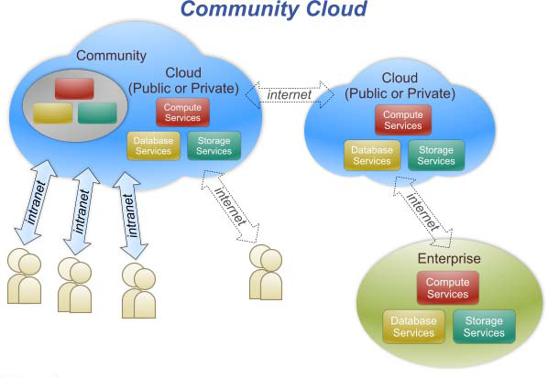
Community Cloud
Community cloud definition
The cloud infrastructure is shared by several organizations and supports a specific community that has shared concerns (e.g., mission, security requirements, policy, and compliance considerations).

Slide 33
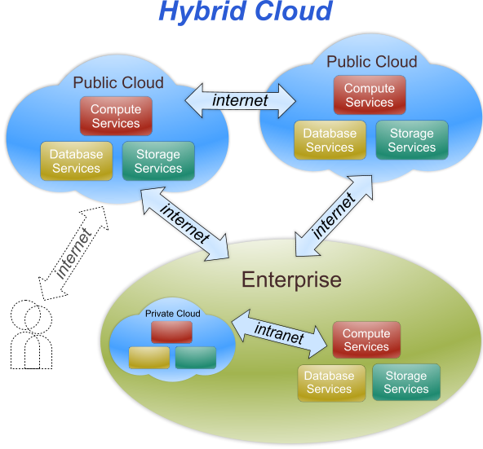
Hybrid Cloud
Hybrid cloud definition
The cloud infrastructure is a composition of two or more clouds (private, community, or public) that remain unique entities but are bound together by standardized or proprietary technology that enables data and application portability (e.g., cloud bursting for load-balancing between clouds).

Slide 34
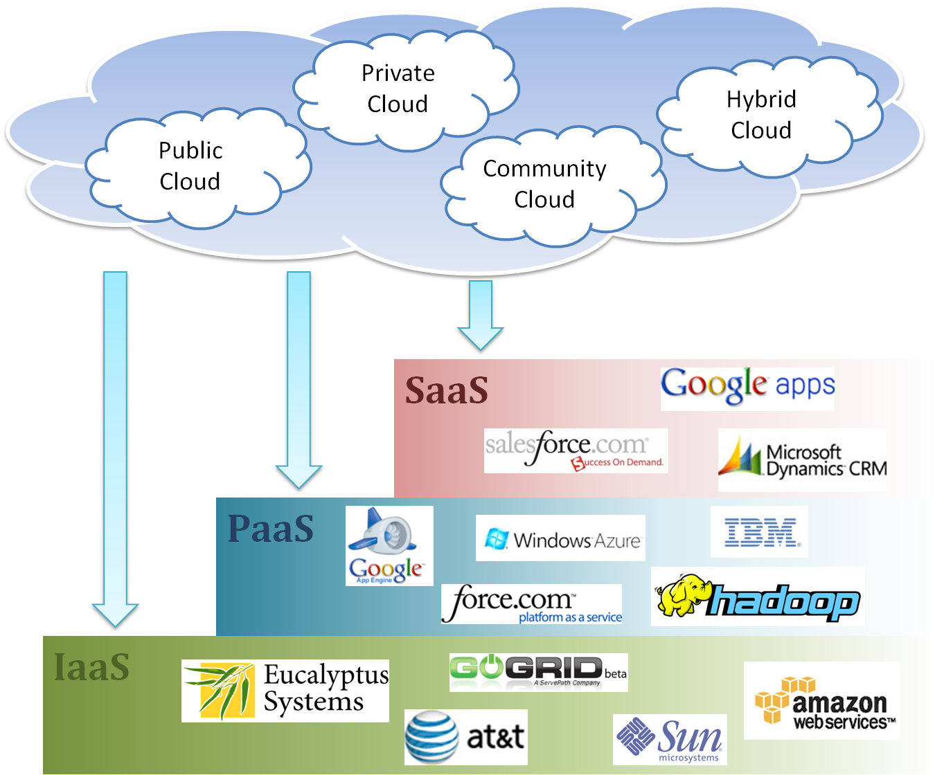
Cloud Ecosystem

Slide 35
Other Deployment models
Distributed cloud: Computing done by distributed set of machines that are running at different locations and they are connected to a single network. Examples
BOINC and Folding@Home. Example: voluntarily shared resources.
Multicloud: When multiple cloud vendors provides service together in heterogeneous architecture.This will help in reducing reliance on single vendors, increase flexibility through choice, mitigate against disasters, etc.
Intercloud is an interconnected cloud i.e. "cloud of clouds” similar to Interconnected network (Internet) "network of networks". Mainly inter cloud helps in interoperability between public cloud service providers (as is the case for hybrid- and multi- cloud).

Slide 36
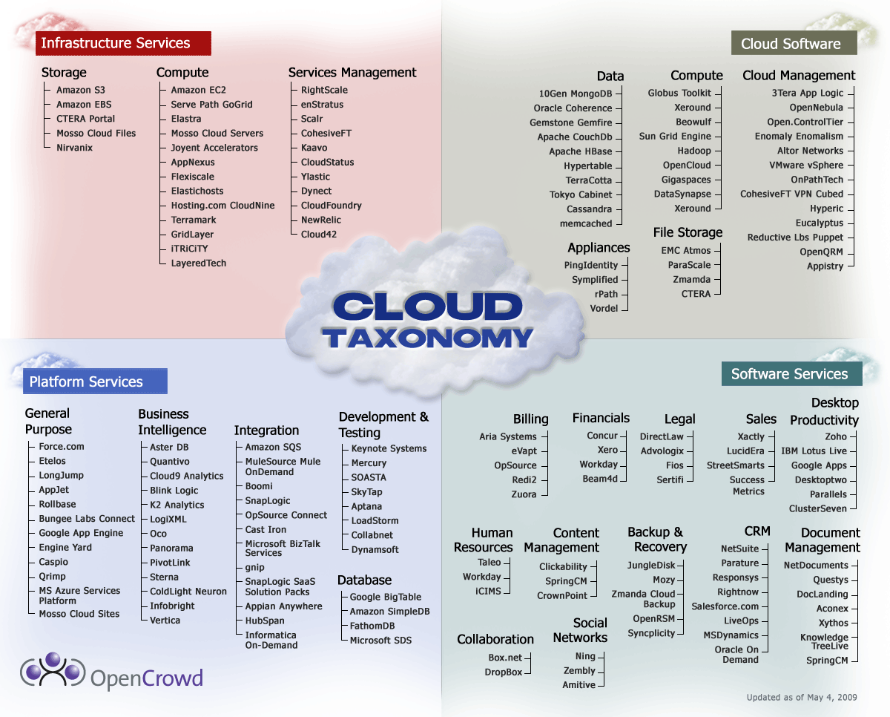
Cloud Taxonomy
Notes:
http://www.opencrowd.com/assets/images/views/views_cloud-tax-lrg.png

Slide 37
Virtualization
Virtual workspaces:
An abstraction of an execution environment that can be made dynamically available to authorized clients by using well-defined protocols,
Resource quota (e.g. CPU, memory share),
Software configuration (e.g. O/S, provided services).
Implement on Virtual Machines (VMs):
Abstraction of a physical host machine,
Hypervisor intercepts and emulates instructions from VMs, and allows management of VMs,
VMWare, Xen, etc.
Provide infrastructure API:
Plug-ins to hardware/support structures
App
App
App
OS
OS
OS
Hypervisor
Hardware
Virtualized Stack

Slide 38
Virtual Machines
VM technology allows multiple virtual machines to run on a single physical machine.
App
App
App
App
App
Xen
Guest OS
(Linux)
Guest OS
(NetBSD)
Guest OS
(Windows)
VMWare
VM
VM
VM
Virtual Machine Monitor (VMM) / Hypervisor
UML
Denali
Hardware
etc.
Performance: Para-virtualization (e.g. Xen) is very close to raw physical performance!

Slide 39
Virtualization in General
Advantages of virtual machines:
Run operating systems where the physical hardware is unavailable,
Easier to create new machines, backup machines, etc.,
Software testing using “clean” installs of operating systems and software,
Emulate more machines than are physically available,
Timeshare lightly loaded systems on one host,
Debug problems (suspend and resume the problem machine),
Easy migration of virtual machines (shutdown needed or not).
Run legacy systems!

Slide 40
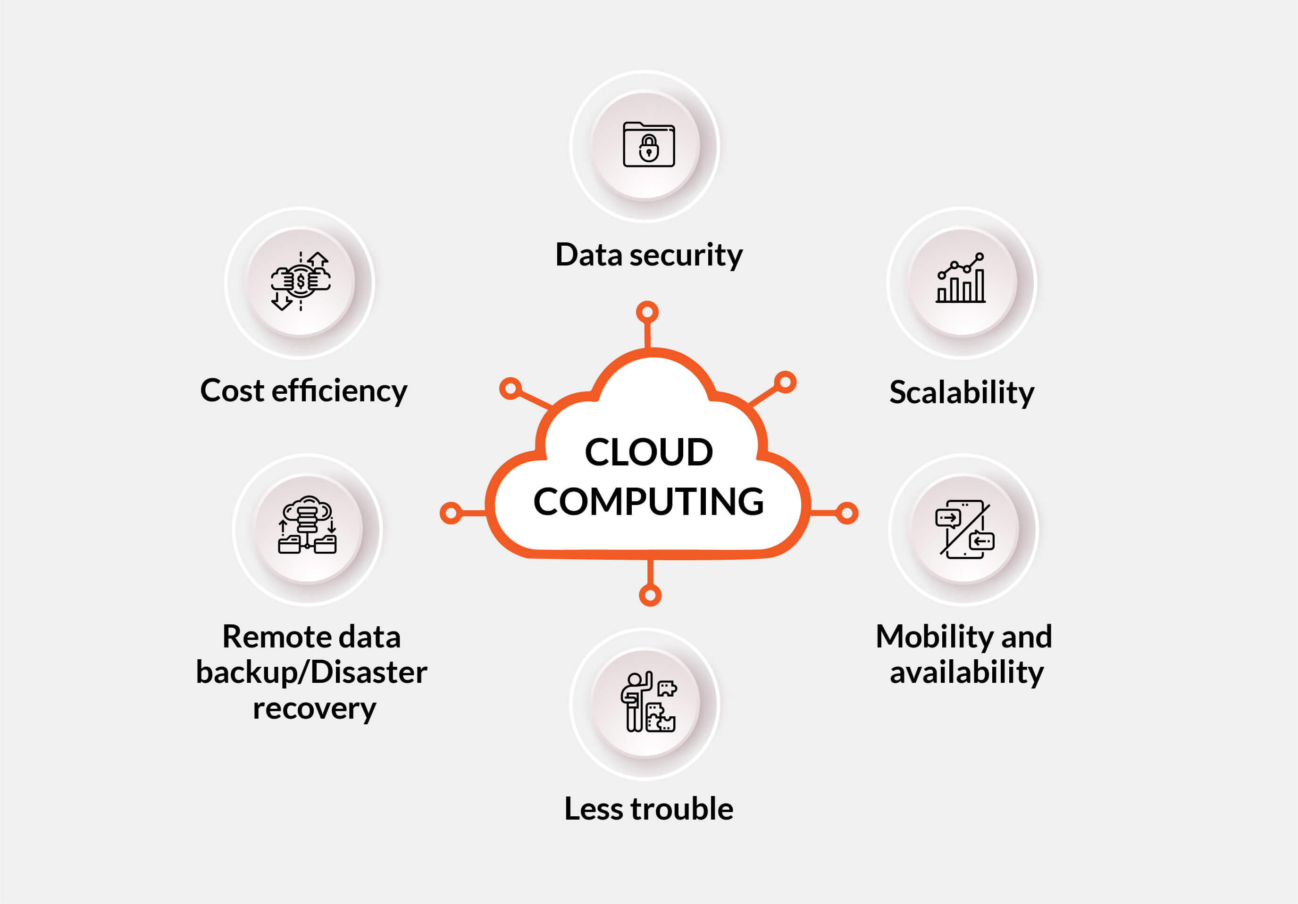
THE ADVANTAGES OF CLOUD COMPUTING

Slide 41
DATA SECURITY
A number of security measures are taken by the cloud hosting vendors to prevent data loss and ensure a safe computing environment in the multi-tenant infrastructure. These include access restrictions to apps and system resources, logging, monitoring and control of access and use of apps and systems, employment of security architecture models with app-level configurations, as well as the implementation of baseline protections like user authentication, encryption, SSO, API controls contracts and so on..
Dr. Mohammad Aladwan

Slide 42
MOBILITY AND AVAILABILITY
The cloud service providers take care to make your personal or corporate data available for you 24/7 provided you remember your credentials and have access to any computer device with a stable Internet connection (which is really not a problem these days). This way, you can stay up-to-date on important issues instantly, easily store, retrieve, recover and process your data anytime and anywhere. Also, remote data access gives the opportunity for teams and colleagues to collaborate on a single shared project, without creating multiple copies of any document, no matter which part of the world each of them is located in. And you don’t need to have files in your device memory any more to share them with people - just send data as web links to your target recipients to download from.

Slide 43
SCALABILITY
Using the on-premise server collection can be like buying clothes you’ll never wear: first, you thought you’d need it but it turned out to be unfitting. And now you don’t know what to do with it. Or, in case of rapid growth, you suddenly realize you need some extra storage and capacity right now, but you have to take extra time and effort to build and set up a new server infrastructure. This problem can be easily eliminated due to cloud services.
Whenever you need flexibility in computer capacity and storage, moving to the cloud will be an ideal choice. On-demand cloud computing platforms providing their services on a pay-as-you-go basis allow their customers to use as many resources as needed at a particular moment. This is also a great benefit for small businesses that are planning to grow quickly or aren’t sure exactly how many resources they might need for their functioning.

Slide 44
LESS TROUBLE
If you are using any in-house hardware that looks at least a bit more advanced than a regular laptop, you definitely need a team of IT professionals to handle all the possible issues arising from it.
Unlike using the physical servers, cloud computing, from the admin point of view, is fairly easy to manage and, the best part about it, cloud service providers take the responsibility for maintaining their systems, ensuring the proper levels of performance, security and control, as well as managing all the forthcoming updates and potential threats off-sight. Isn’t it amazing?

Slide 45
REMOTE DATA BACKUP/DISASTER RECOVERY
Everybody knows how it feels when important information is lost due to possible malware, hardware crashes or deterioration, a simple user error or a lame power cut, and even a natural disaster. That’s what you may be expecting when using physical on-premise servers to store your own or your client’s data. Such troubles may cost you your company revenues, brand positioning, customer loyalty and trust.
With the cloud services, however, you can be pretty certain about your data backup and disaster retrieval opportunities. On the remote servers, the data is arranged and stored on multiple servers in the network. A reserve copy of your files is made instantly and transferred to a secondary, off-site location regularly by the provided settings or as soon as data updates take place.

Slide 46
COST EFFICIENCY
Compared to having your own physical servers, using cloud services might seem more expensive. Although having taken into account everything said before, the benefits of cloud computing significantly outweigh the costs. In addition, moving to the cloud helps companies to avoid some extra expenses like capital investment in hardware, IT staff salary, rent for a bigger office with a server room, and even electricity bills (yes, physical servers and air conditioners for them are pretty power-hungry).

Slide 47
Disadvantages of Cloud Computing
A list of the disadvantage of cloud computing is given below -
1) Internet Connectivity
As you know, in cloud computing, every data (image, audio, video, etc.) is stored on the cloud, and we access these data through the cloud by using the internet connection. If you do not have good internet connectivity, you cannot access these data. However, we have no any other way to access data from the cloud.
2) Vendor lock-in
Vendor lock-in is the biggest disadvantage of cloud computing. Organizations may face problems when transferring their services from one vendor to another. As different vendors provide different platforms, that can cause difficulty moving from one cloud to another.

Slide 48
Disadvantages of Cloud Computing
3) Limited Control
As we know, cloud infrastructure is completely owned, managed, and monitored by the service provider, so the cloud users have less control over the function and execution of services within a cloud infrastructure.
4) Security
Although cloud service providers implement the best security standards to store important information. But, before adopting cloud technology, you should be aware that you will be sending all your organization's sensitive information to a third party, i.e., a cloud computing service provider. While sending the data on the cloud, there may be a chance that your organization's information is hacked by Hackers.

Slide 49
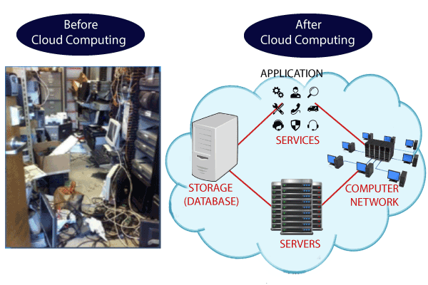
CLOUD COMPUTING

